Slide 1
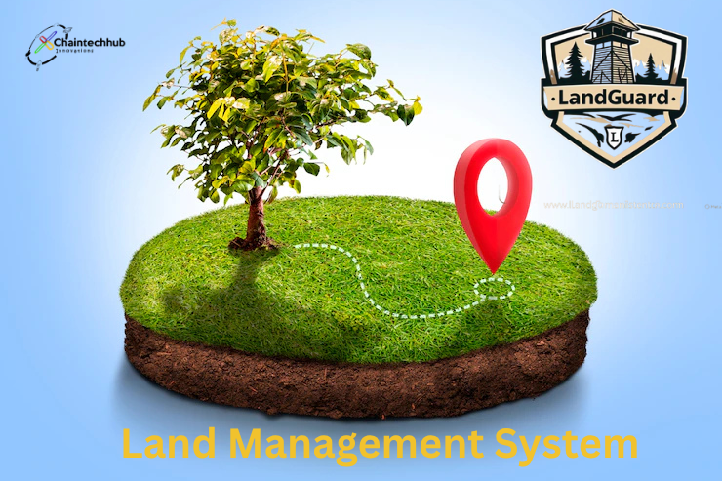
Presented by: Chain Tech Hub
Africa Blockchain Championship 2025 www.chaintechhub.com
Secure Land Ownership
on the Blockchain
"One Deed At a Time"

Slide 2
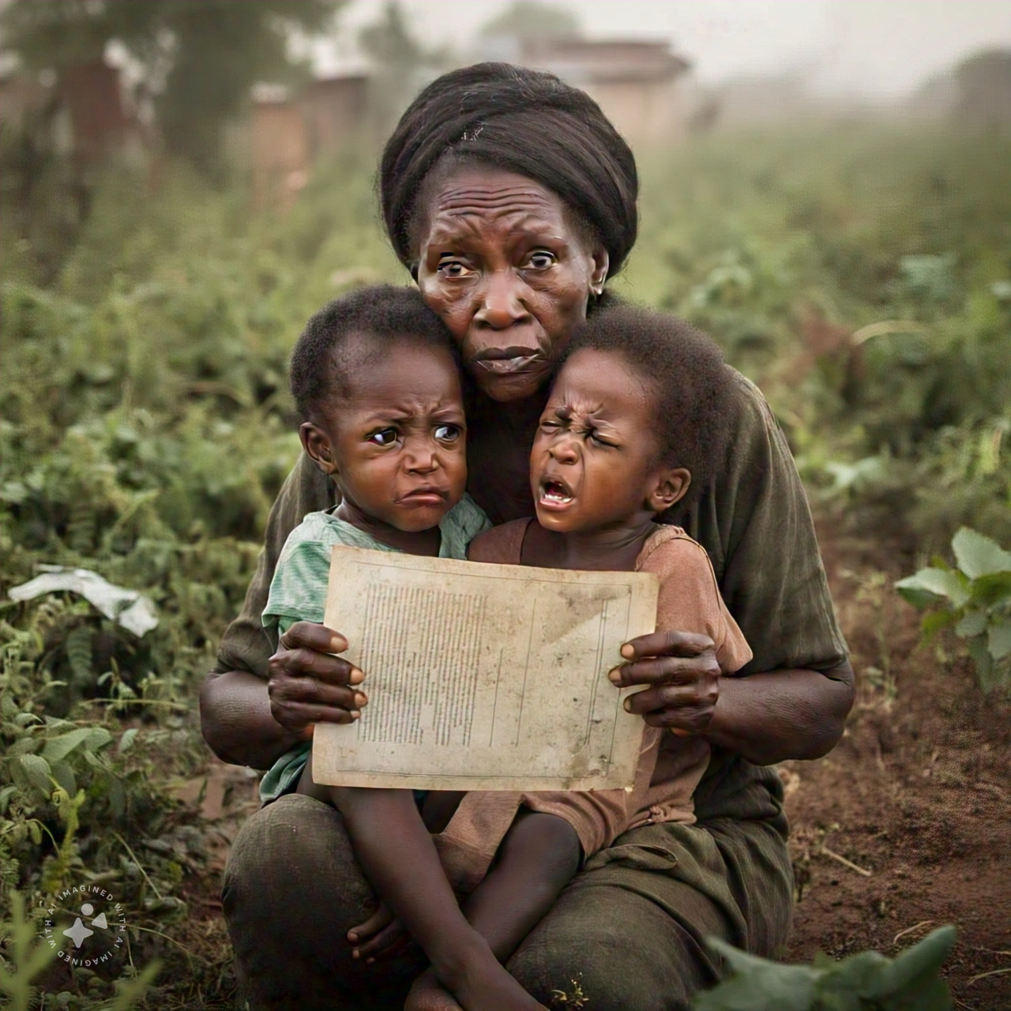

Problem Snapshot
🧱 70% of land in Malawi is undocumented 🚫 Double-selling/Allocation & fraud are rampant ⏳ Social Cohesion (Burkina Faso) 💸 $250M+ diaspora remittances risk unsafe investments
A Story of Betrayal - Miss R Banda
A Story of Loss - Mrs Grace Phiri

Slide 3

SOLUTION
Impact: Verified. Transparent. Secure land transactions.
🔗 Blockchain-powered land registry
📍 GPS-mapped ERC-1155 land NFTs
🛡️ Real-time marketplace with dispute resolution
📱 Mobile-friendly + offline sync

Slide 4
Buyer accesses verified marketplace and purchases land P2P
Ownership recorded immutably with all metadata linked
Real-time updates, alerts, and resolution in case of disputes
How It Works
Land mapped via GPS and verified by local authorities (Land Code)
Land NFT minted and stored on blockchain (IPFS and OnChain)
Land Guard Demo

Slide 5
Unique Value Proposition
First blockchain land registry in Malawi
Supports urban and rural land transactions
Tamper-proof ownership records using NFTs
Peer-to-peer marketplace with real-time updates
Designed for inclusivity: mobile-first, offline sync, low fees

Slide 6
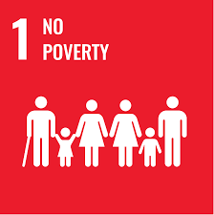


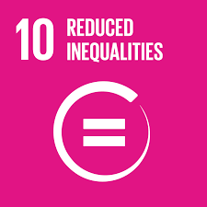




SDGs UNDP Alignment
When your land is secure, your future is possible
From inheritance rights to co-ownership, LandGuard breaks the cycle of silent exclusion
A verified title is more than a document — it’s a gateway to jobs and prosperity
Access to truth is access to power
We can’t build justice alone — but together, we can code it into the continent
Digital deeds mean planned growth
LandGuard empowers owners to think not just of today, but of generations to come
Where ownership is clear, peace is possible.

Slide 7

Tech Stack
Solidity smart contracts (ERC-1155) on Avalanche
GIS integration for land mapping
Frontend: React Native (Mobile), React (Web)
Backend: Node.js, MySQL, IPFS for off-chain storage
QA: Hardhat testing + testnets deployments
Chain ID: 335
RPC URL: https://subnets.avax.network/defi-kingdoms/dfk-chain-testnet/rpc
Currency Symbol : JEWEL
Explorer: https://subnets-test.avax.network/defi-kingdoms/address/0x4E5446D1De4cd3c6A6a81D6F64d3E323D8c8ee6D

Slide 8
Market Opportunity
1
2
3
4
Malawi land registry reform under 2063 Vision
Over 10 million rural landowners and growing urban market
Diaspora remittances (over $250M/year) seeking safe land investments
Scalable where land issues persist

Slide 9
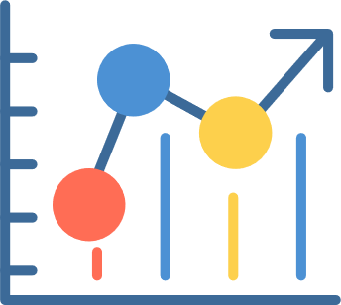
Business Model
Transaction fees on land sales
API licensing e.g. banks
B2G contracts for land digitization

Slide 10
Competitive Landscape
Platform | Geography | Marketplace | NFT Land Proof | GPS Mapping | Dispute Resolution
LandGuard | Malawi | Yes | Yes (ERC-1155) | Yes | Yes
Bitland | Ghana | No | Yes | Partial | No
Seso Global | Nigeria | Yes | No | No | No
Ubitquity | Global | No | Yes | No | No

Slide 11
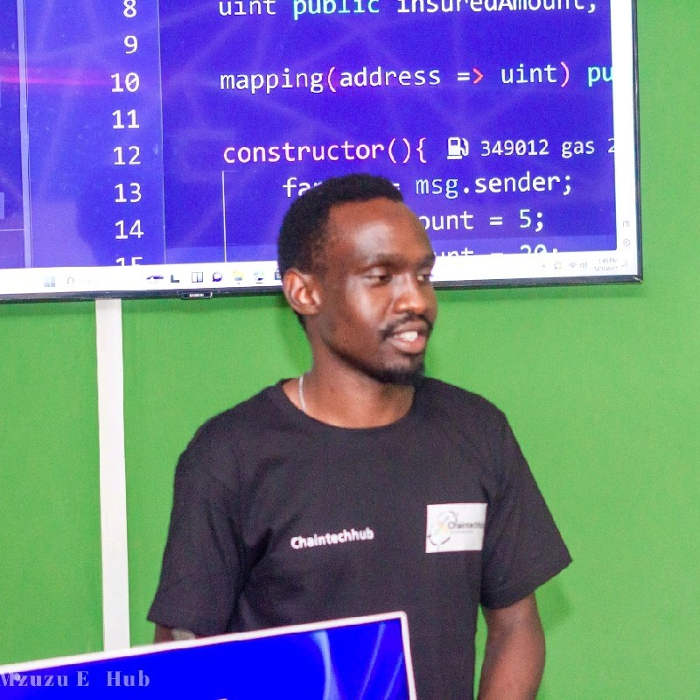
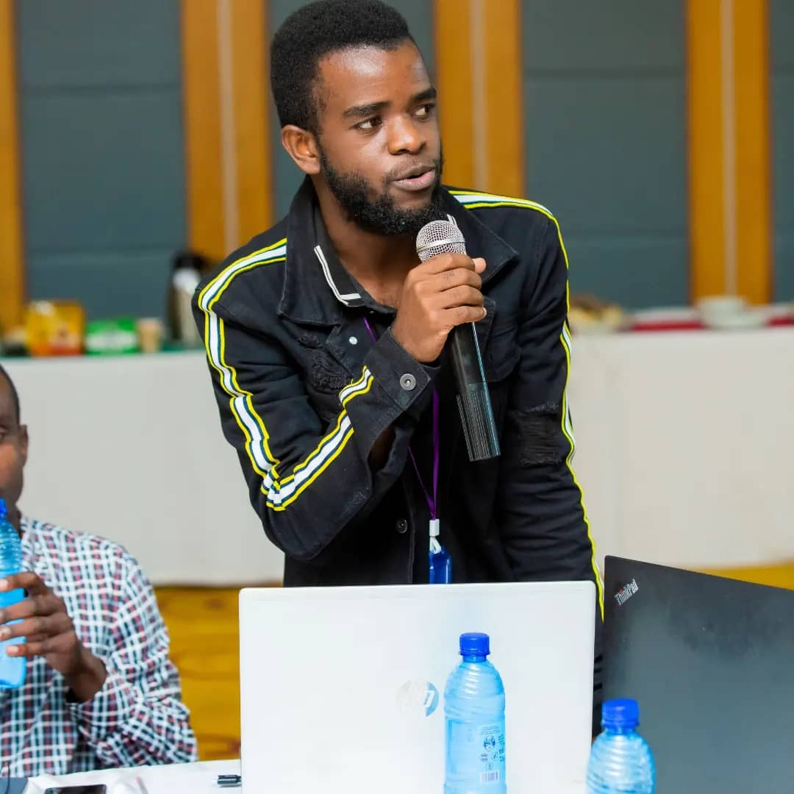
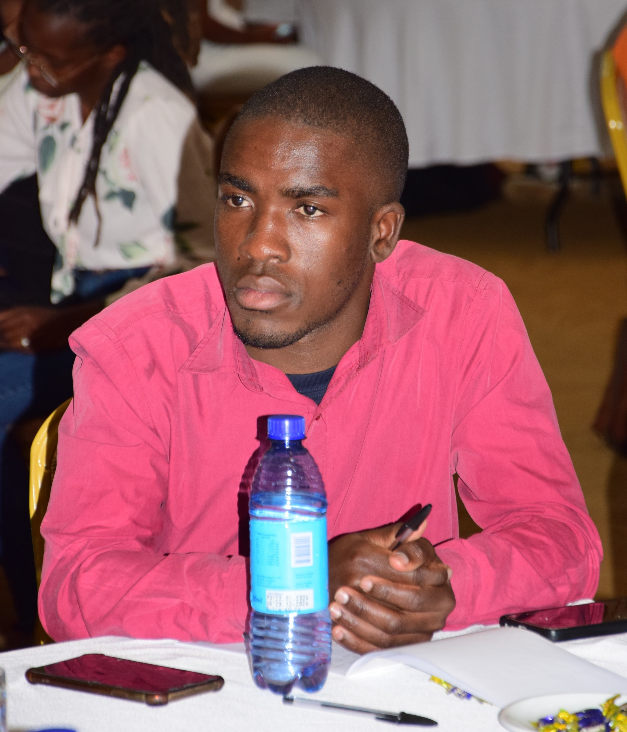

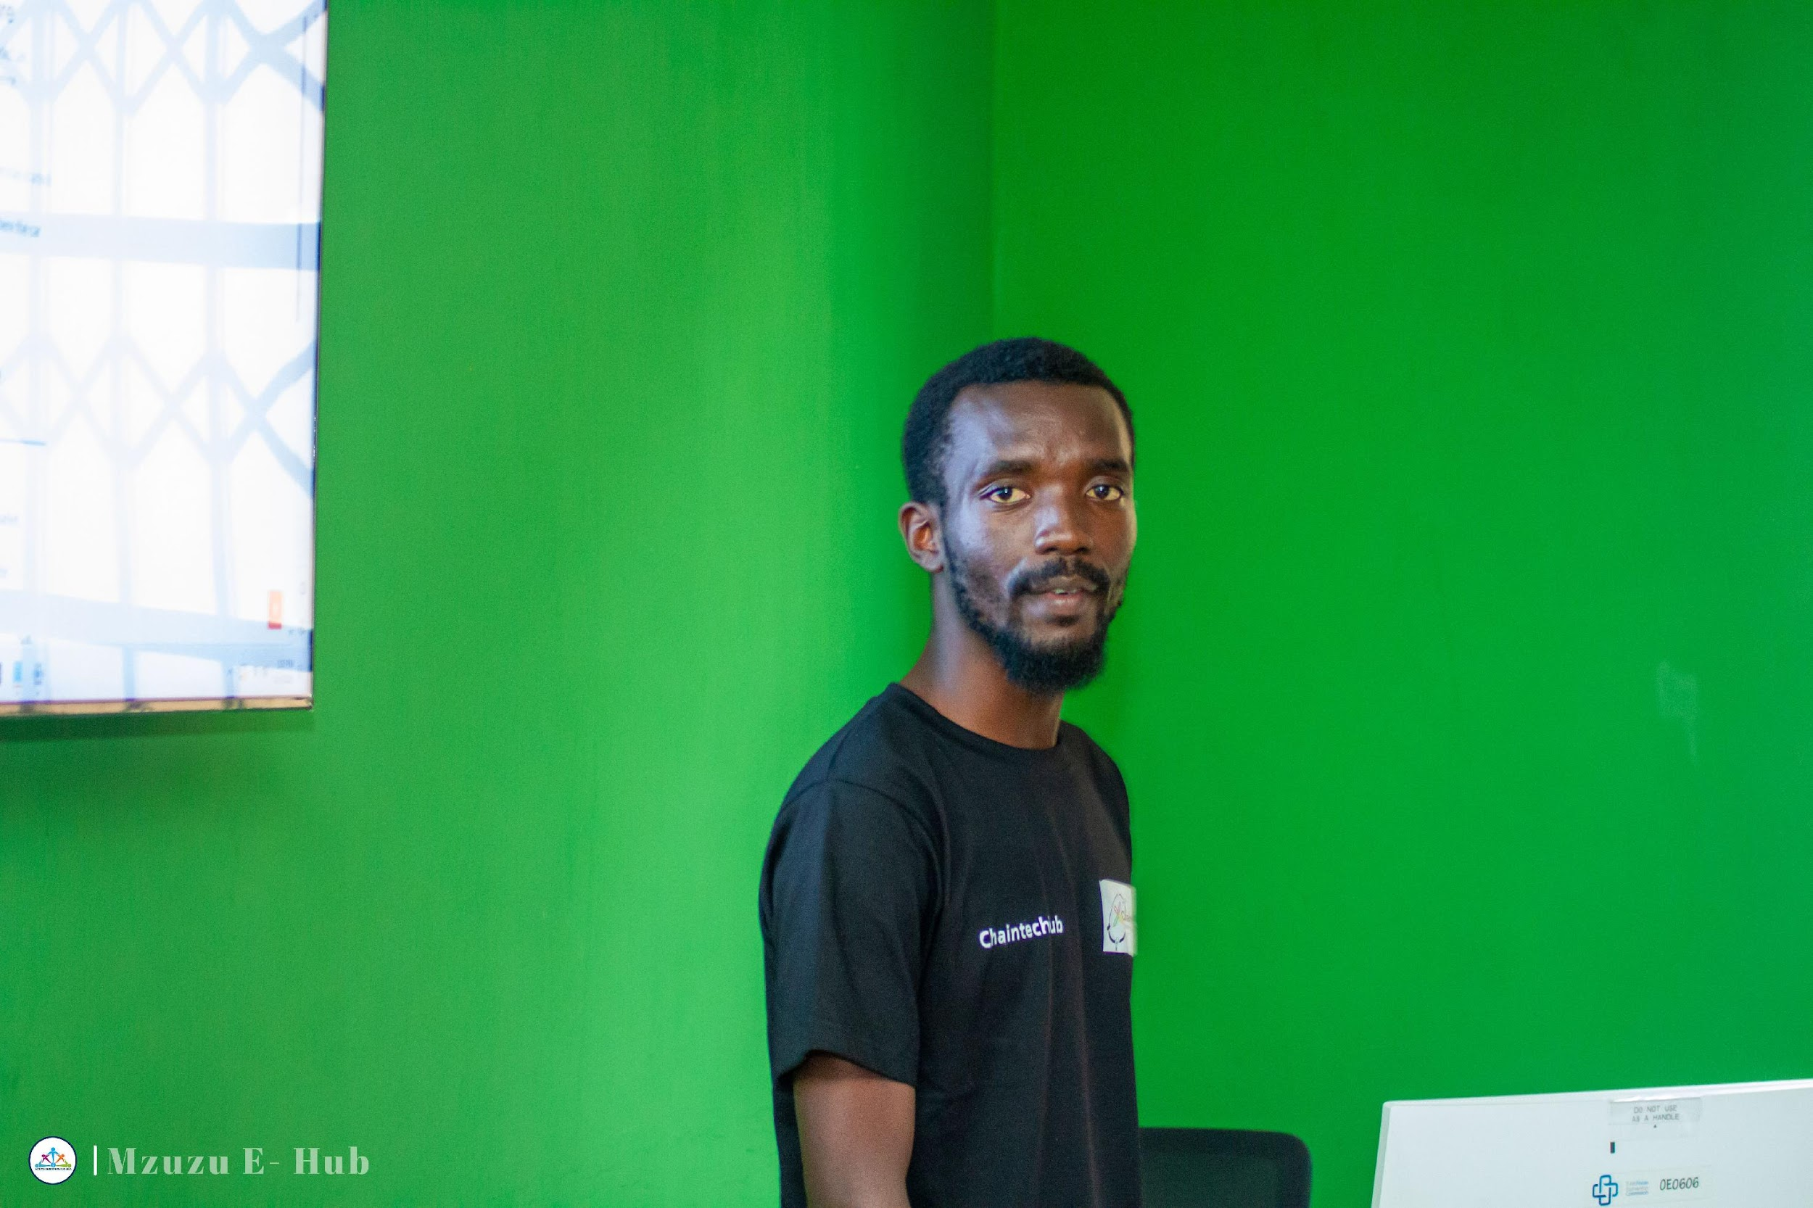
TEAM
Jeremiah Somela
Diploma in Computer Science
Chief marketing Officer
Prince Nsusa
BSc ICT & Mathematics
Chief Executive Officer
Christopher Manganyera
Marketing Officer
Blessings Kapalamula
BSc Renewable Energy
Chief Technology Officer
Prisca Chifisi
BSc Agriculture
Chief Operations officer

Slide 12

Ask
$85k
Smart Contracts dev & depoyment
GIS mapping module
50 pilot users onboarded from peri-urban zones
Marketplace UI + dispute module

Slide 13


Thank
You
"Securing Africa's land, one deed at a time.“
Connect with us: chaintechhub.com/landguard github.com/Chain-Tech-Hub Partner with us to unlock land justice for millions.
+265-888-001-347
hello@chaintechhub.com

